Slide 1
Makers
and
Creators
Notes:
Welcome everyone to this week of makers and creators at campus north.

Slide 2
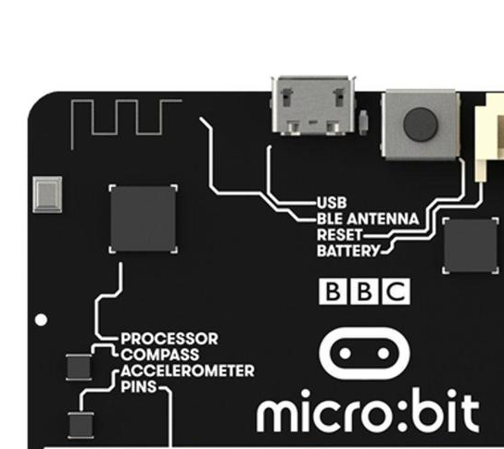
Thursday
Notes:
Today we will be learning about the microbit sensors and connecting the microbits in lots of different ways.

Slide 3
Introducing…
Notes:
your mentors for today - each say who you are and what you do and what your favourite bit of computer science is.

Slide 4
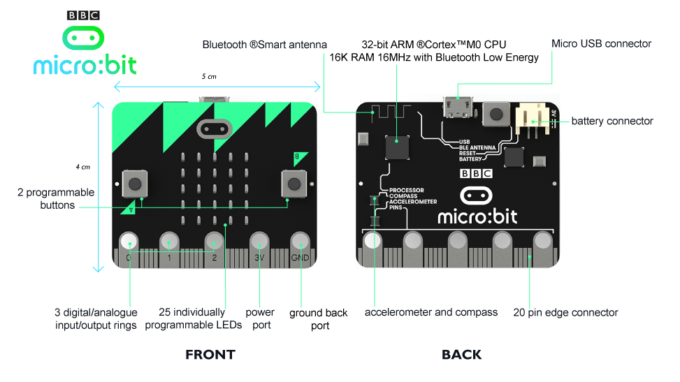
Notes:
Inputs and outputs on bottom, speech synth, radio, accelerometer.
May want to work in pairs for these tasks?

Slide 5
Let’s get connected
Notes:
Plug cable into usb and plug other end into the port on the board. Don’t worry about touching it, you won’t get a shock and you won’t break anything.
The lead gives the unit power so keep it connected at all times.
Things to note - the display on one side. Two buttons left and right are a and b. The connector on the back and next to it a reset button. If everything is going wrong you can press that to restart your program.

Slide 6
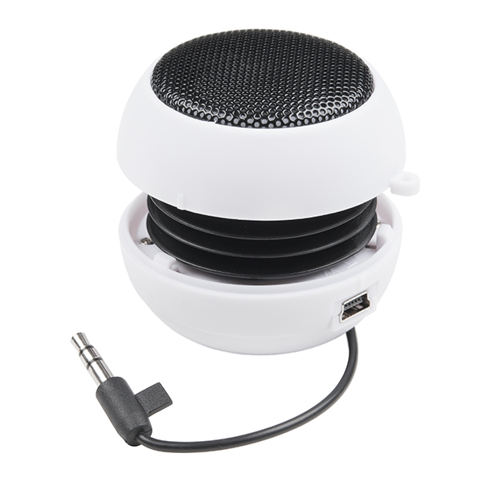
Charge
Notes:
ALSO - Connect USB speaker to give them a charge - will need them later

Slide 7
Always
from microbit import *
Notes:
Always need this as the first thing in the program, even if we forget to mention.

Slide 8
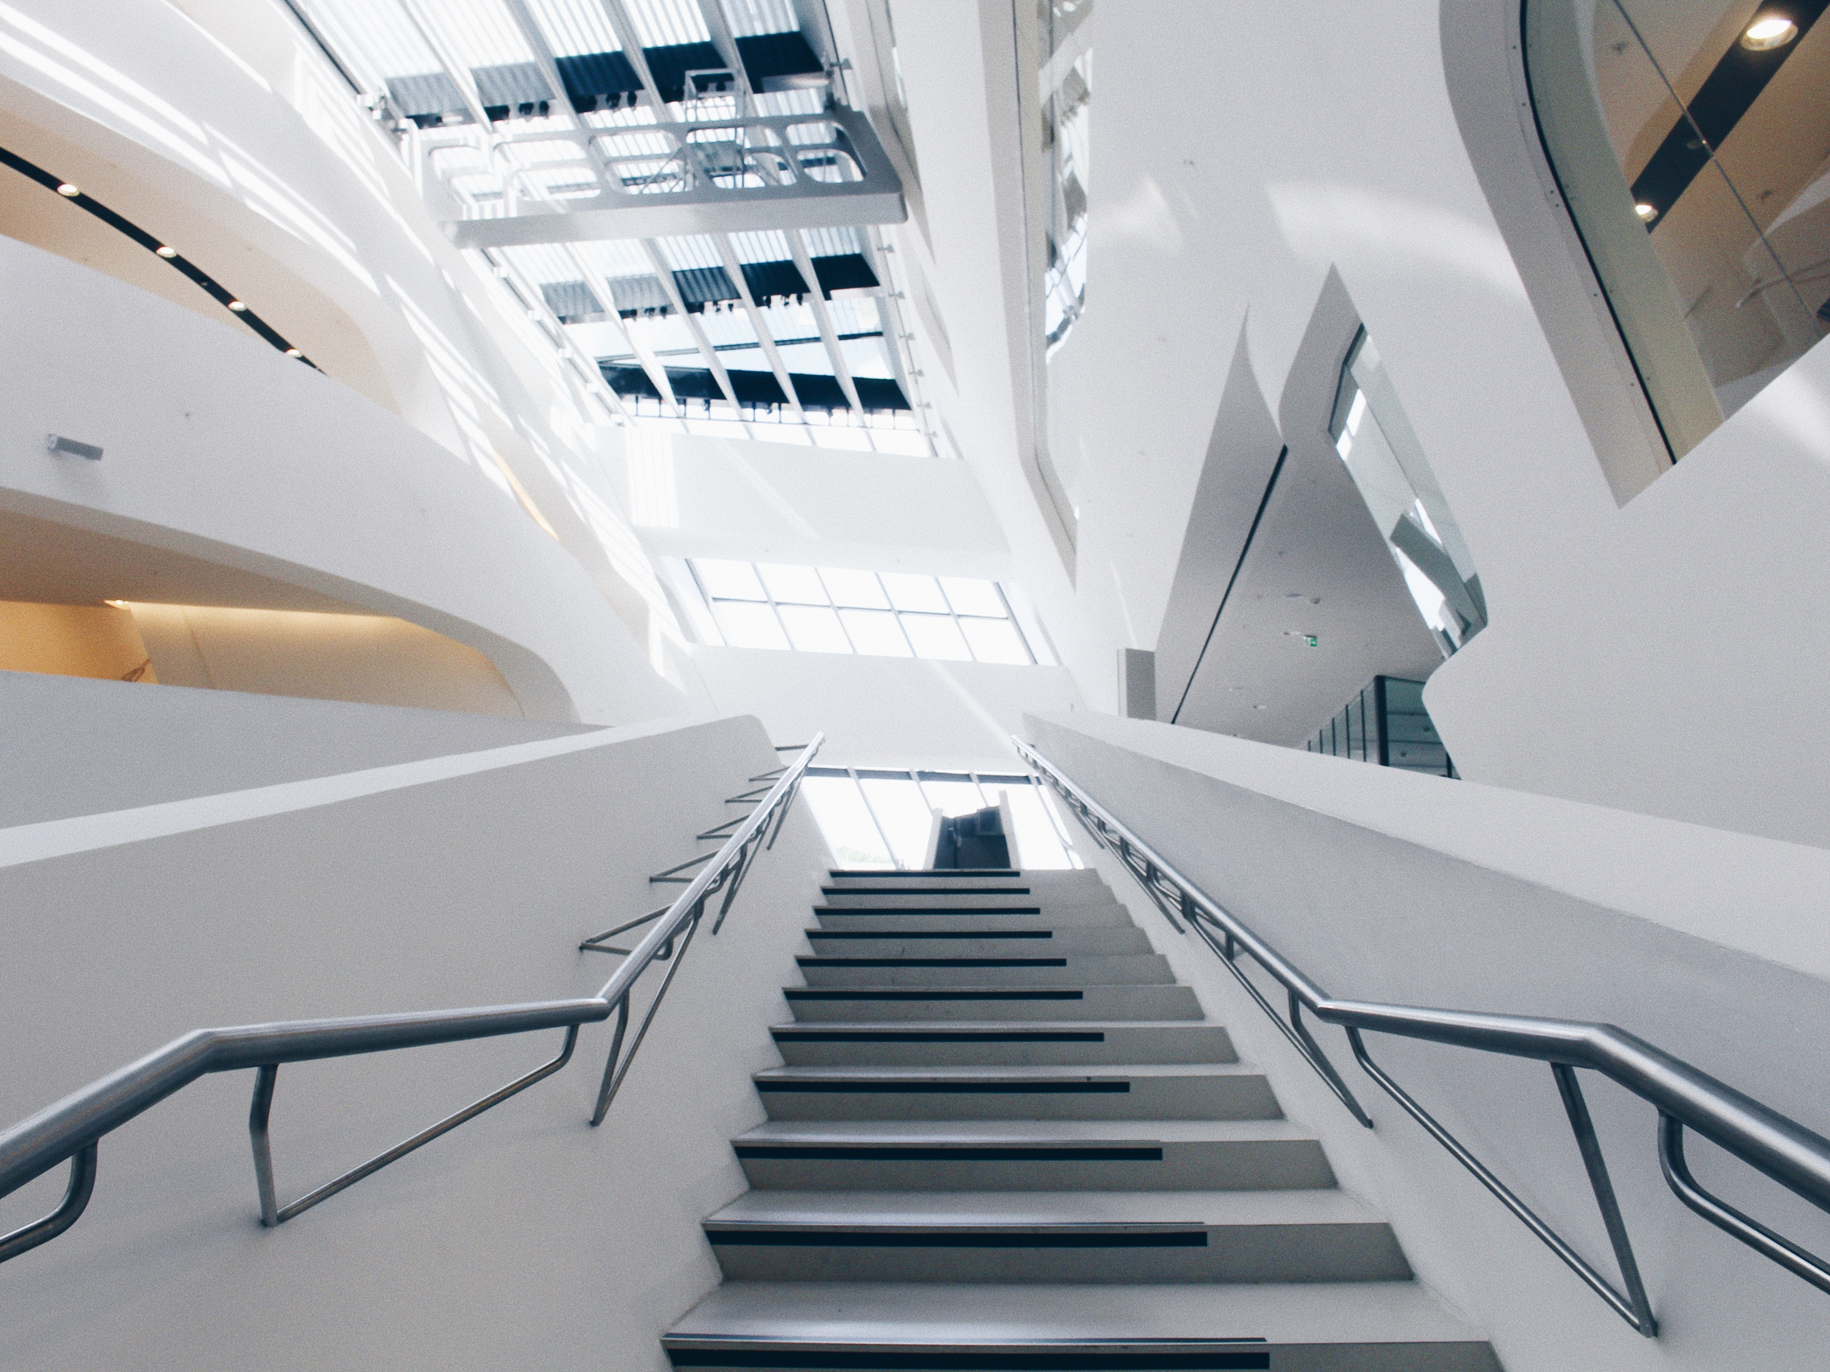
Step Counter
Notes:
Step Counter

Slide 9
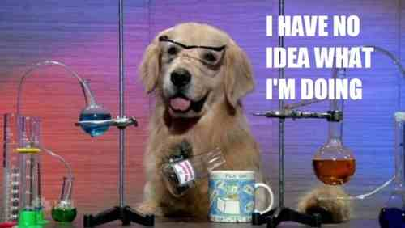
Experiment
Notes:
We want to build a step counter that counts every step we take.
The easy way is to count how many shakes the microbit senses…

Slide 10
from microbit import *
steps = 0
while True:
if accelerometer.was_gesture("shake"):
steps += 1
display.show(Image.HAPPY)
sleep(200)
display.clear()
if button_a.was_pressed():
display.scroll(str(count))
Notes:
We count how many steps, each time a step is counted we show a happy face.
If we push the a button we can see the current total.
Try it out and see how accurate it is.

Slide 11
Results ?
Notes:
How did we think that worked? Was it sensitive enough?
Maybe we can use the accelerometer to count more accurately?

Slide 12
from microbit import *
steps = 0
while True:
y = accelerometer.get_y()
if y < 0:
sleep(100)
y = accelerometer.get_y()
if y > 0:
steps += 1
display.show(IMAGE.Happy)
sleep(100)
display.clear()
if button_a.was_pressed():
display.scroll(str(count))
Notes:
Looking at raw data from accelerometer - looking for it to tilt from forward to back (or back to forward) to count a step.
Is that sensitive enough or should we test x as well?

Slide 13
Results ?
Notes:
Ask for feedback from pairs

Slide 14
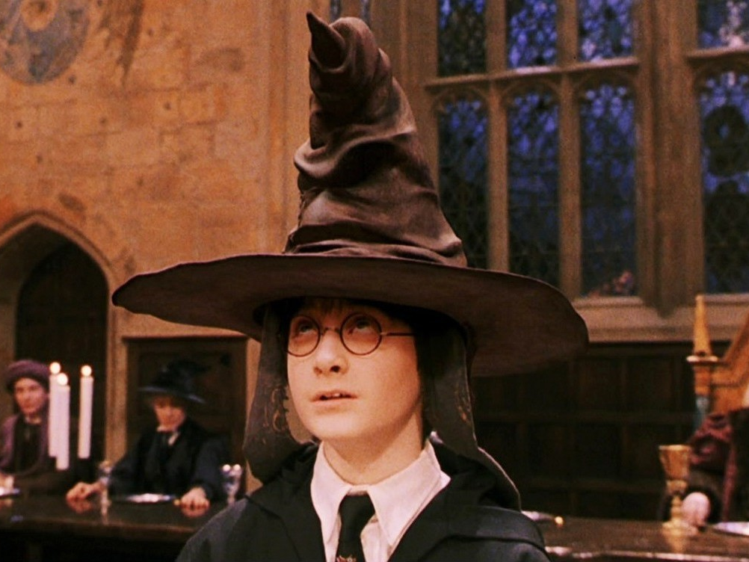
Sorting
Hat
Notes:
Sorting Hat from the film Harry Potter

Slide 15
from microbit import *
import random
hat = Image("07900:60750:07070:09090:99999")
houses = [ "Slytherin", “Hufflepuff", “Ravenclaw", “Gryffindor” ]
while True:
display.show(hat)
if accelerometer.was_gesture("shake"):
house_name = random.choice(houses)
display.scroll(house_name)
sleep(2000)

Slide 16
thinking = [
"Hmm. Difficult",
"Very Difficult...",
"So where shall I put you?",
"Ah, right then",
"Hmm, right",
"Hmm",
“Okay",
"Well, I know just what to do with you...",
"Right, Ok",
"Not Slytherin, Eh?"
]
display.scroll(random.choice(thinking)
Notes:
Also in the film, the hat has to think sometimes…
we can add thinking towards top of program, and add choice before announcing the house.

Slide 17
Notes:
In the film, the sorting hat could talk…

Slide 18
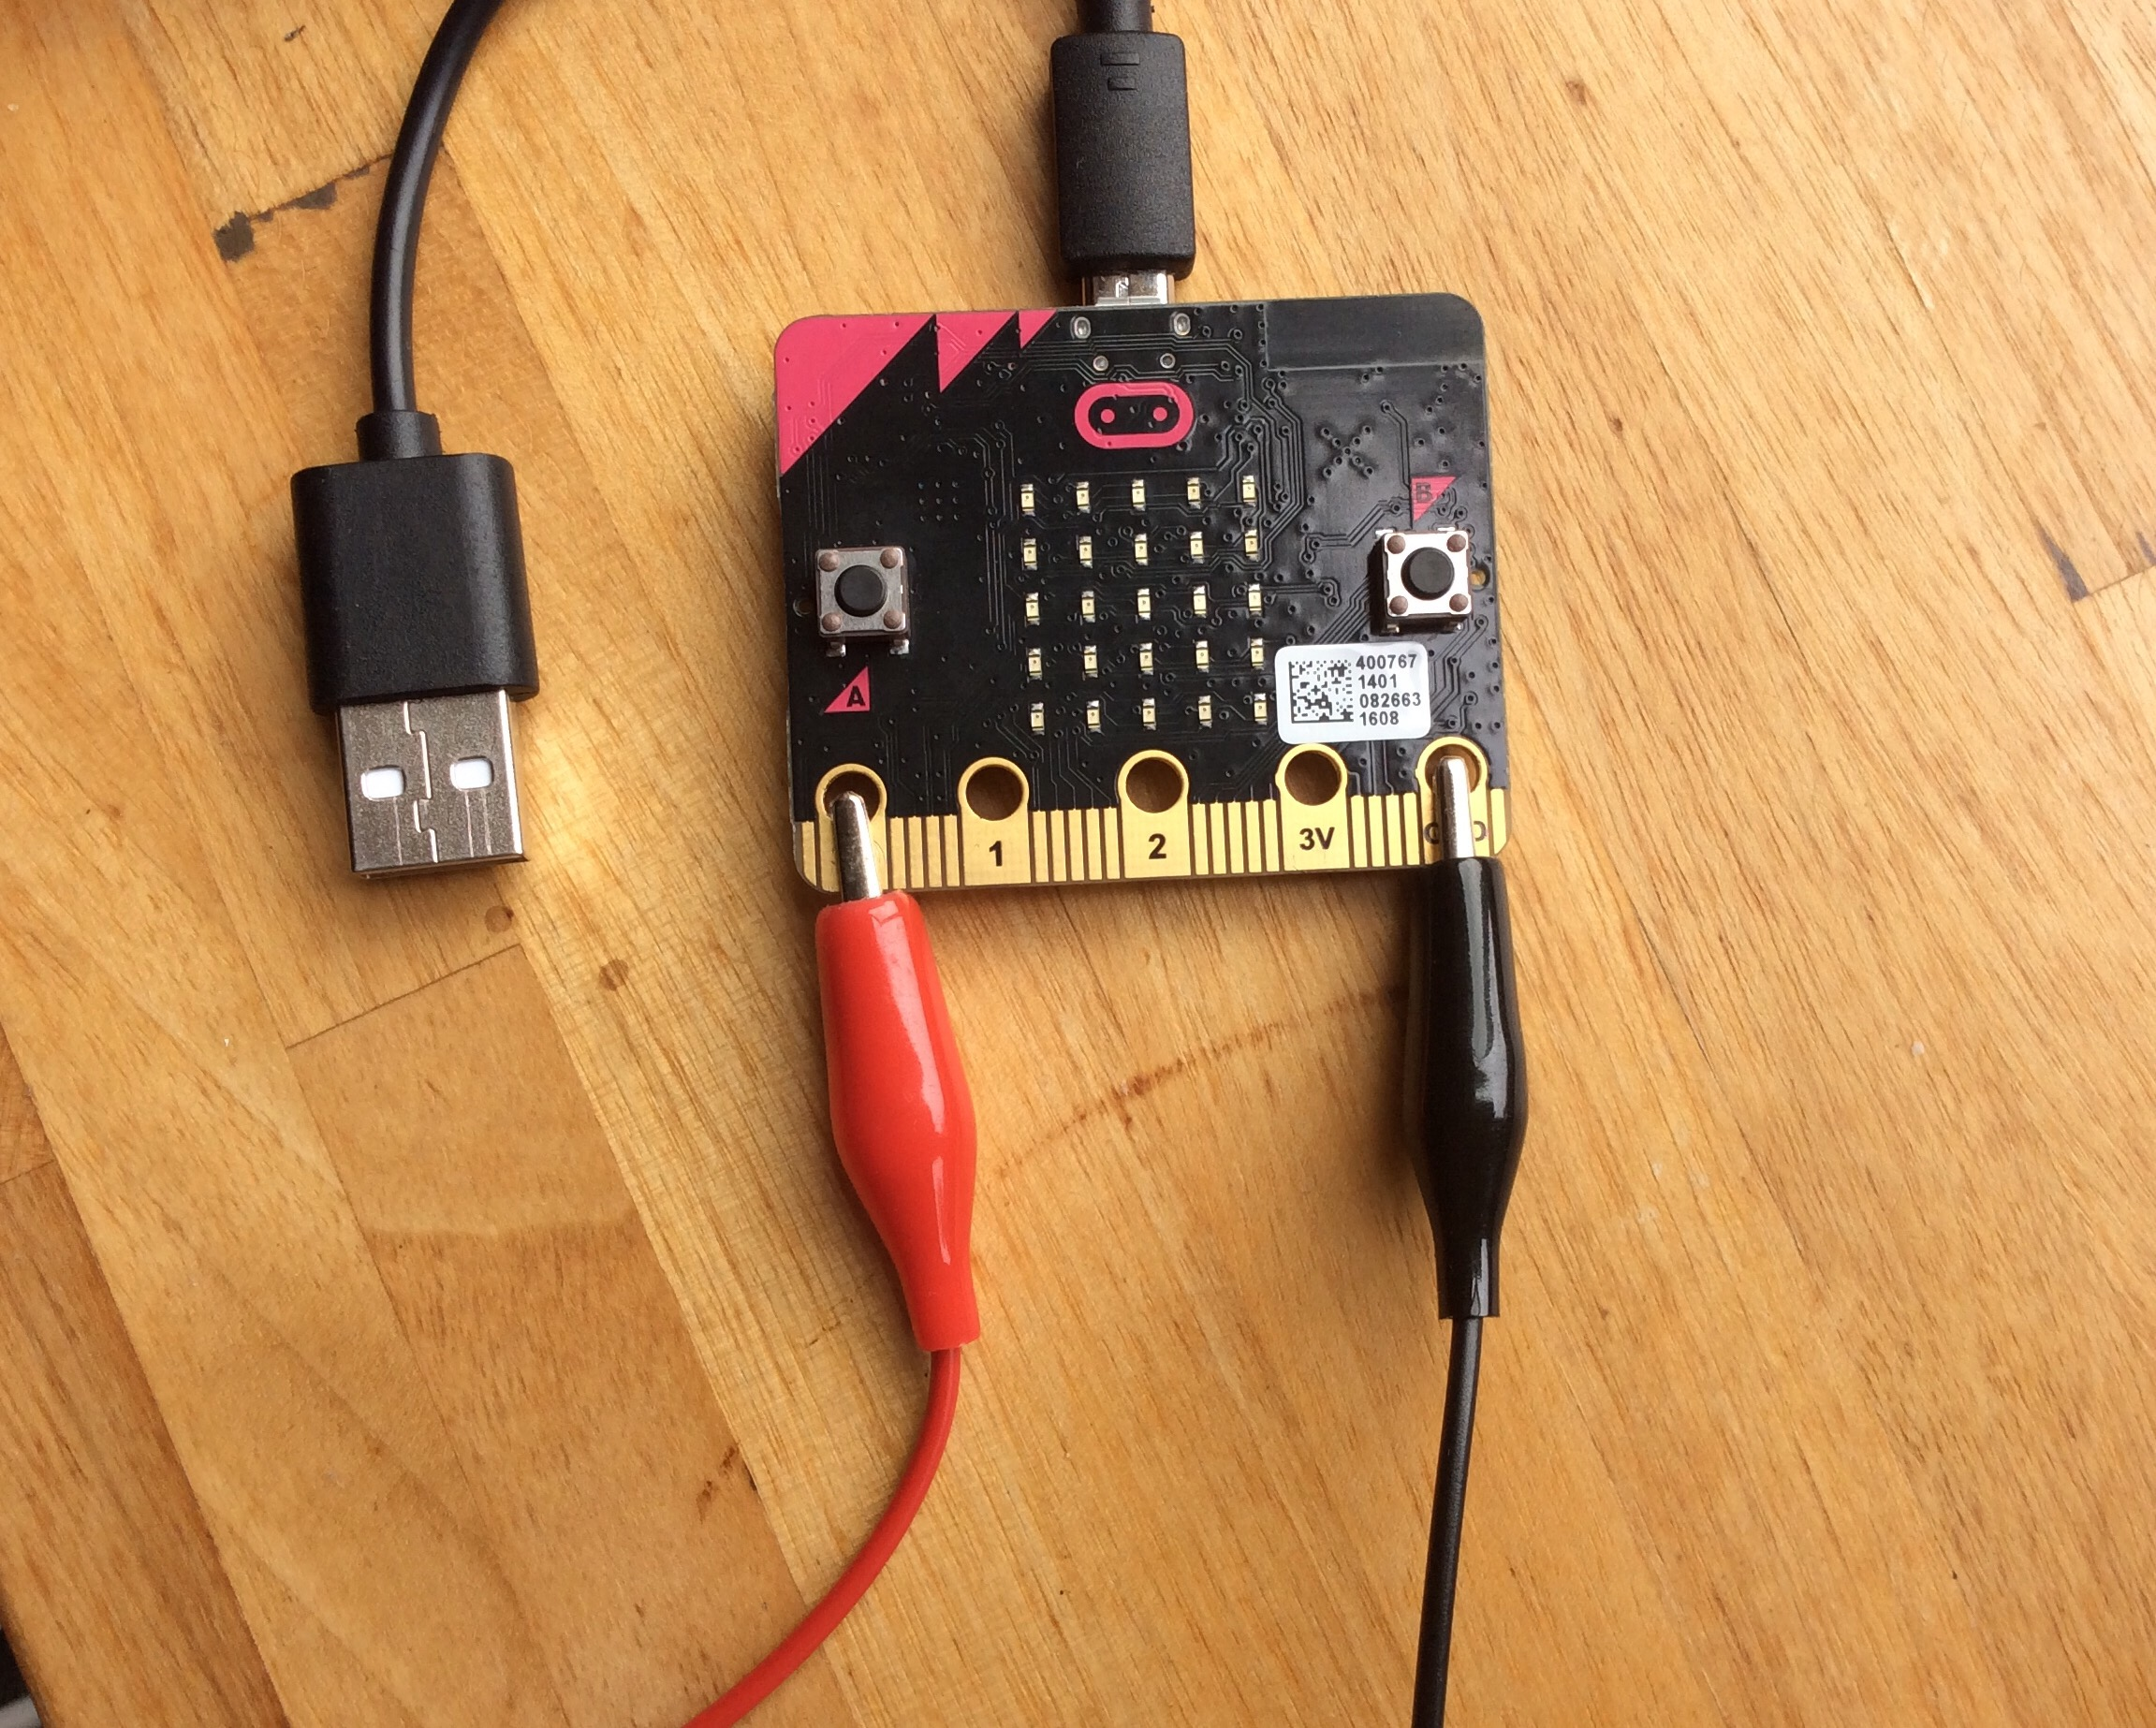
Notes:
Connect speakers to crocodile clips and connect clips to microbit like this.
Turn on speaker

Slide 19
from microbit import *
import speech
.. .
speech.say("I am the sorting hat”)
Notes:
Need to import the speech package. Hat might have some problems pronouncing words. Need to adjust text maybe? Change spelling to be more phonetic.

Slide 20
from microbit import *
import speech
speech.say("I am the sorting hat”,
speed=82,
pitch=72,
throat=110,
mouth=105)
Notes:
We can change how it says things by using some options…
set individual speech qualities - values 0 to 255, don’t need to set all of them - experiment !
Go back and change the original program to include speech.

Slide 21
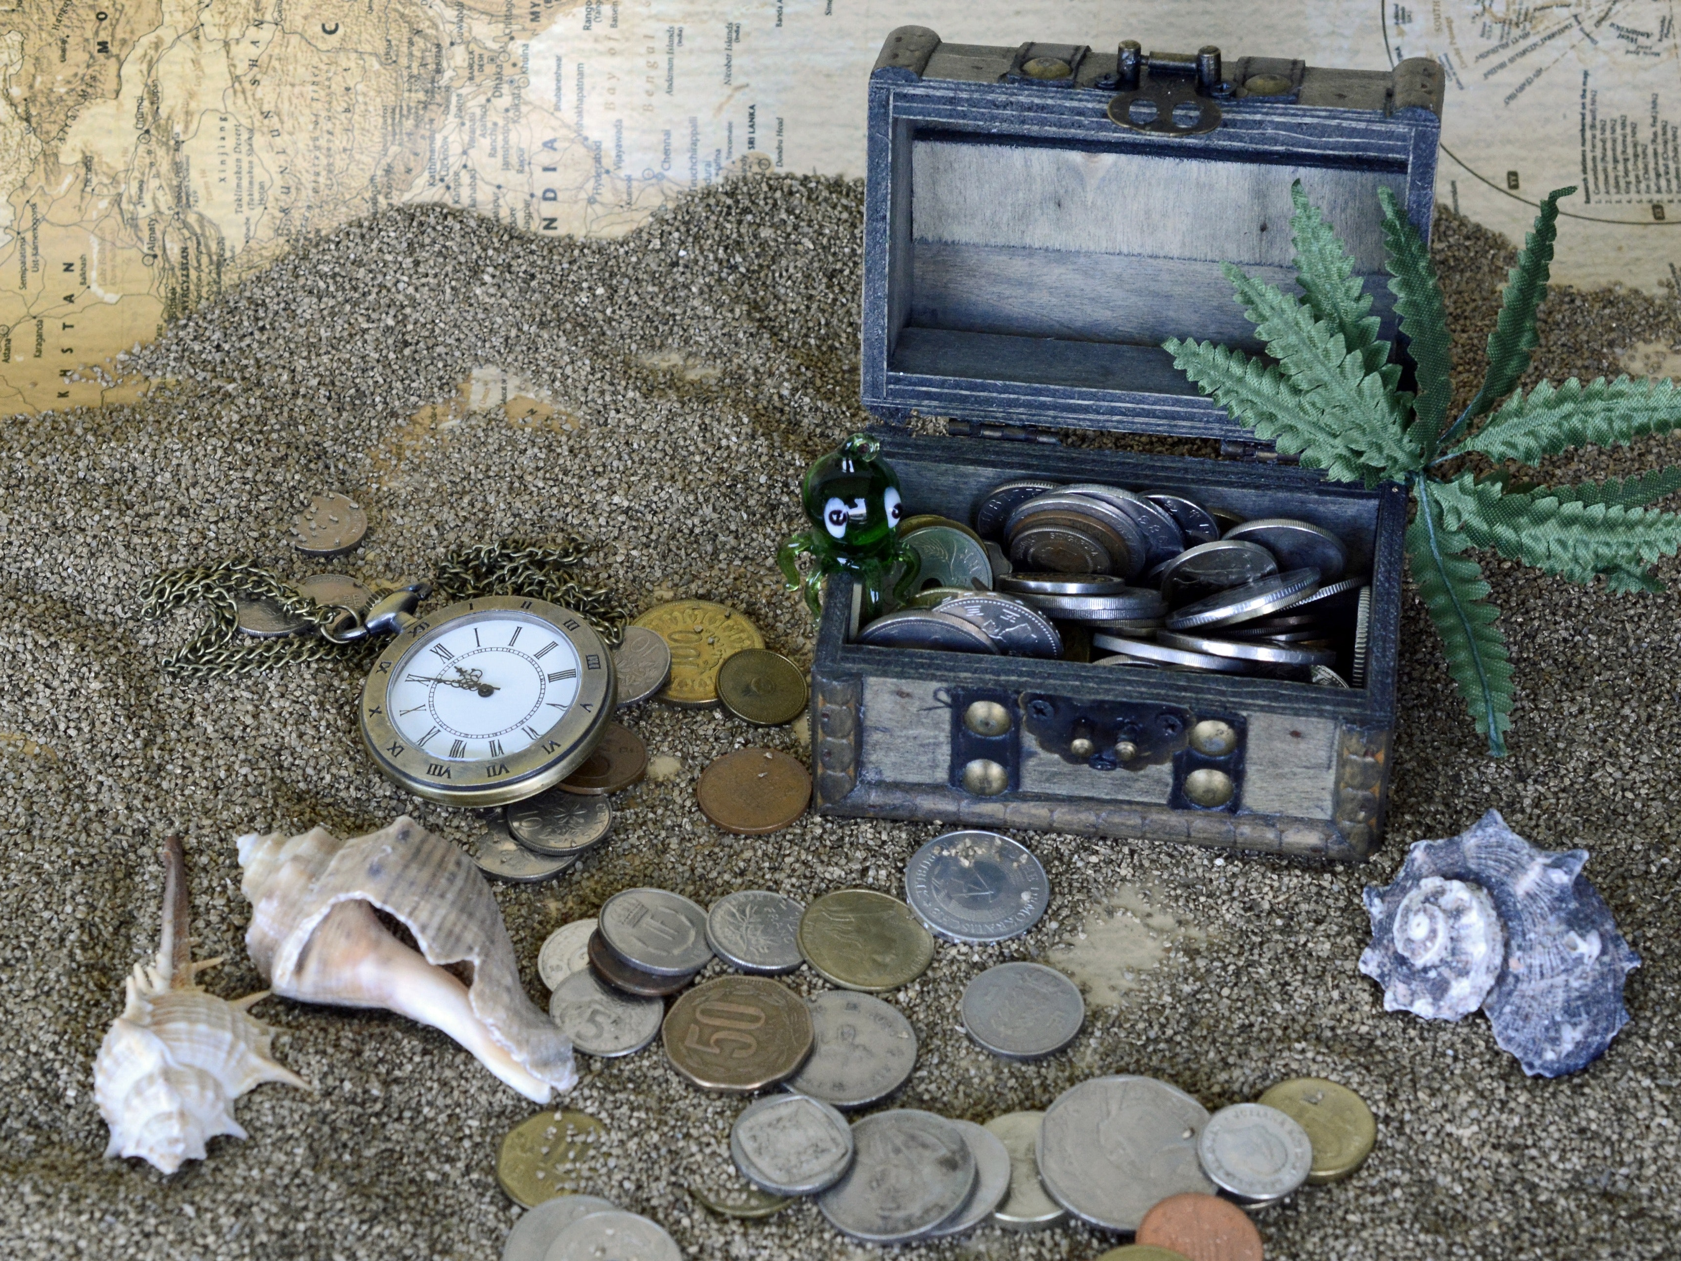
Notes:
Treasure Hunt. Built in two parts transmitter beacons that have clues within them, and a receiver that the person find the treasure uses to pick up the clues.

Slide 22
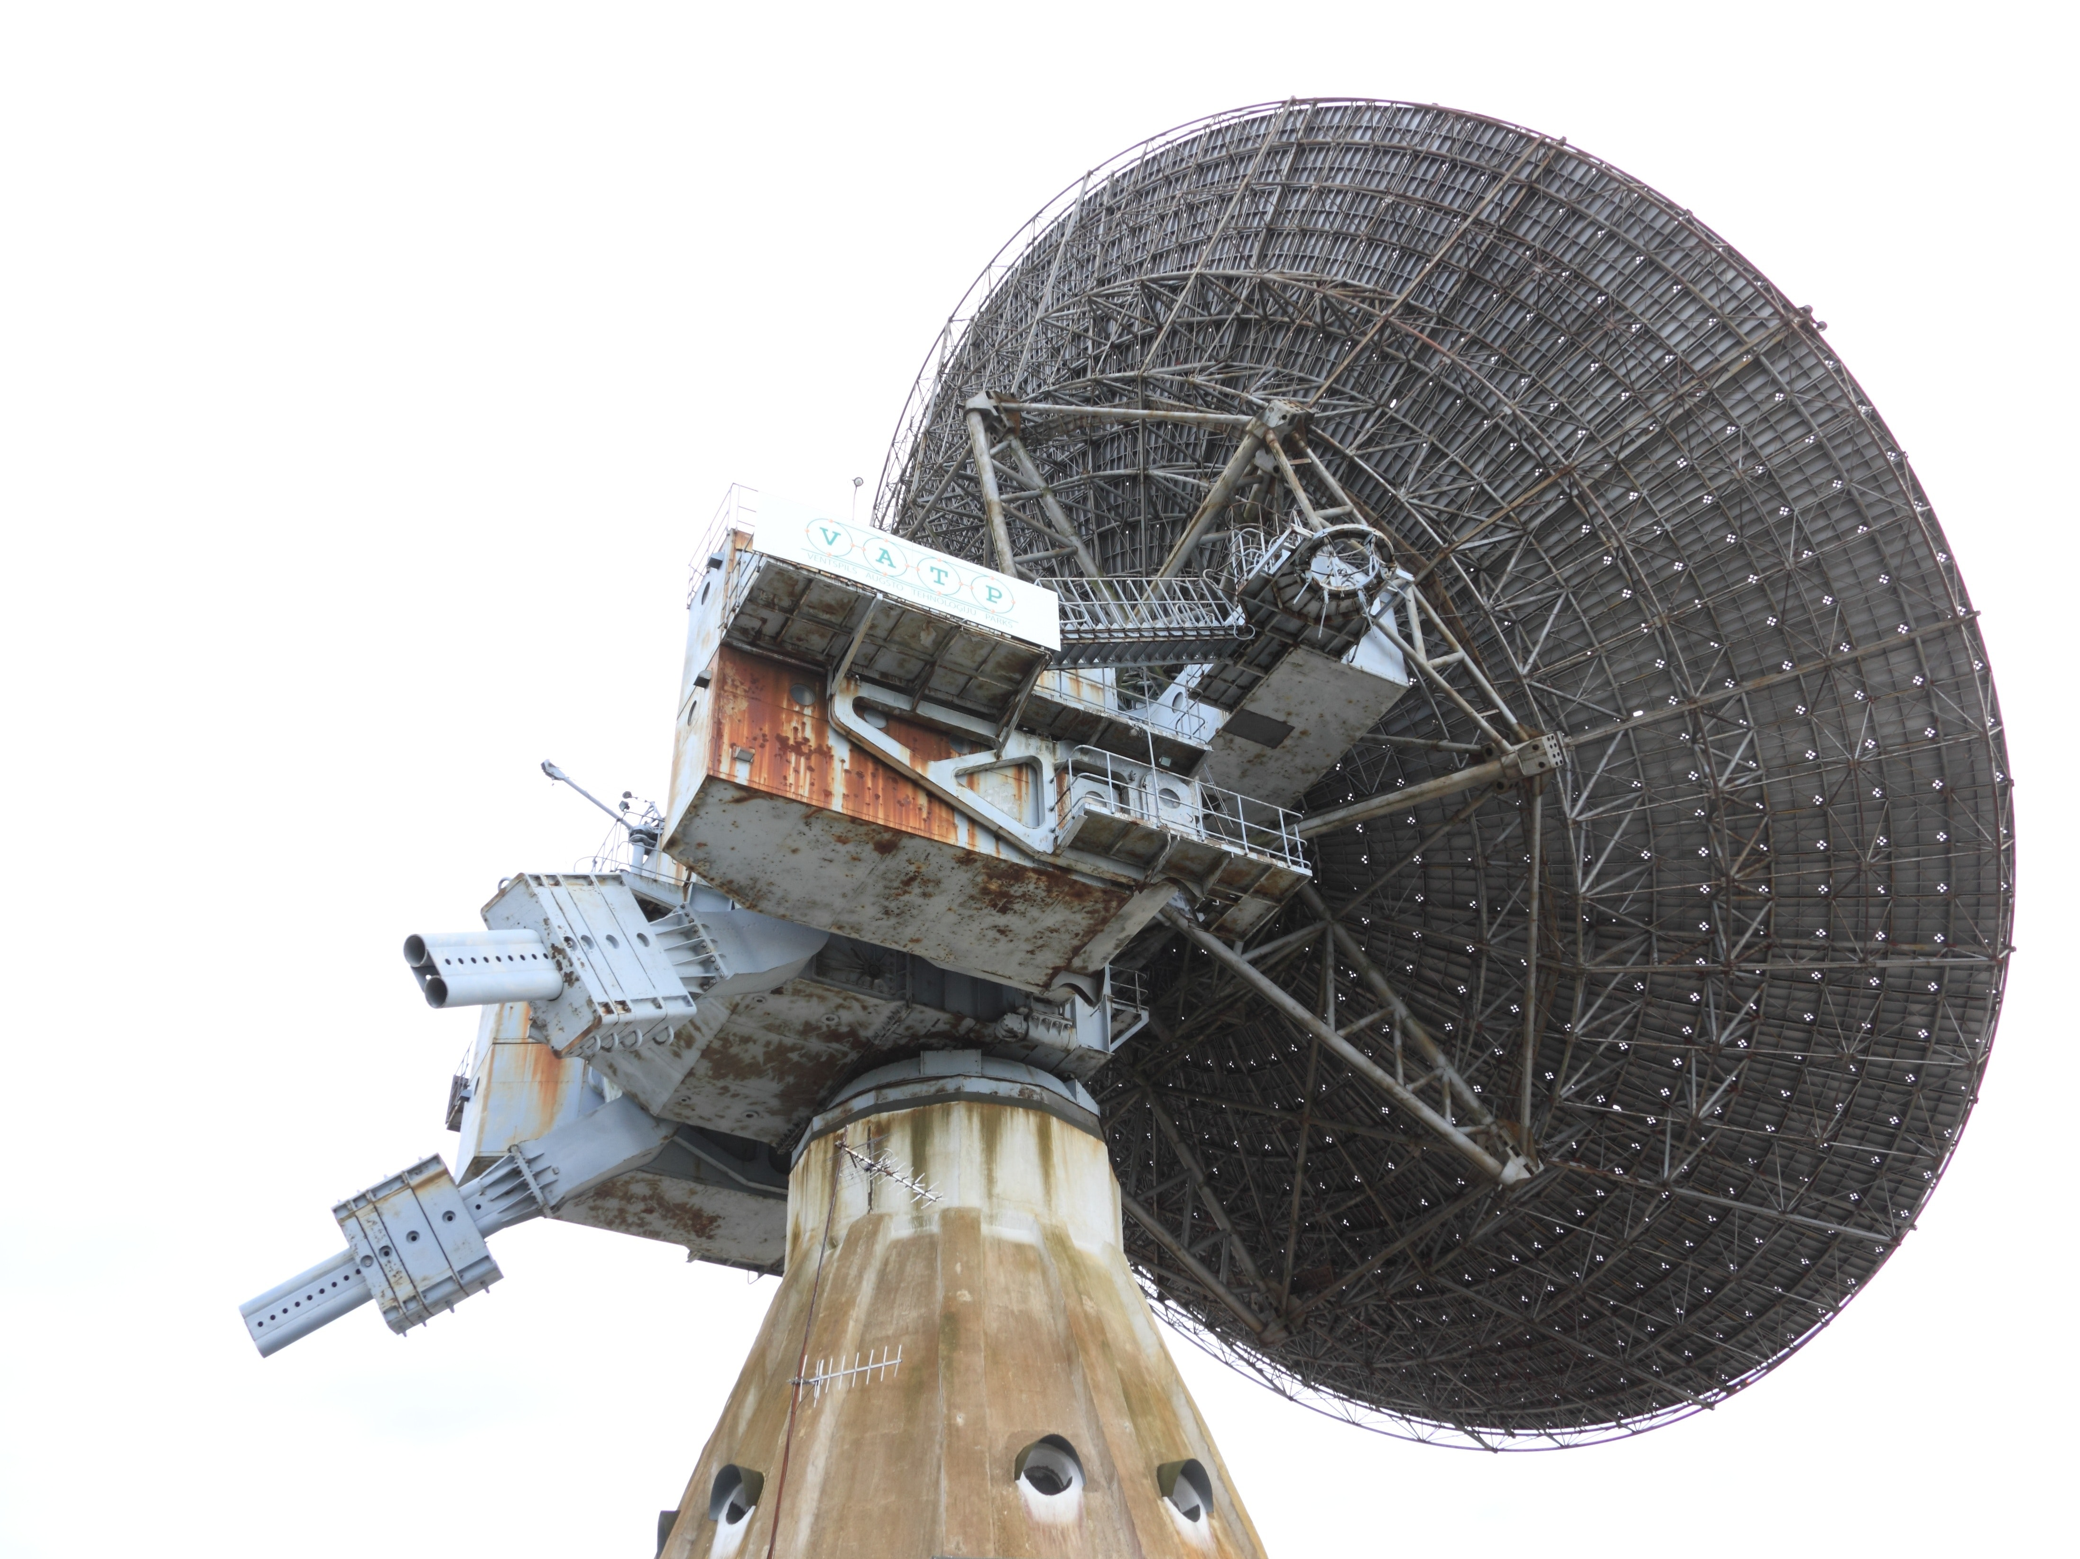
Receiver
Notes:
Receiver - carry around with you to pick up a signal when you are close by.

Slide 23
from microbit import *
import radio
clue = "hint: Walk around to find the first clue"
display.scroll(clue)
next_clue = 1
radio.on()
while True:
display.show("?")
message = radio.receive()
if message:
number, text = message.split(":")
if int(number) == next_clue:
clue = "clue " + str(number) + ":" + text
next_clue += 1
display.scroll(clue)
sleep(100)
Notes:
will only listen out for next clue and ignore any others so have to hunt in sequence.

Slide 24
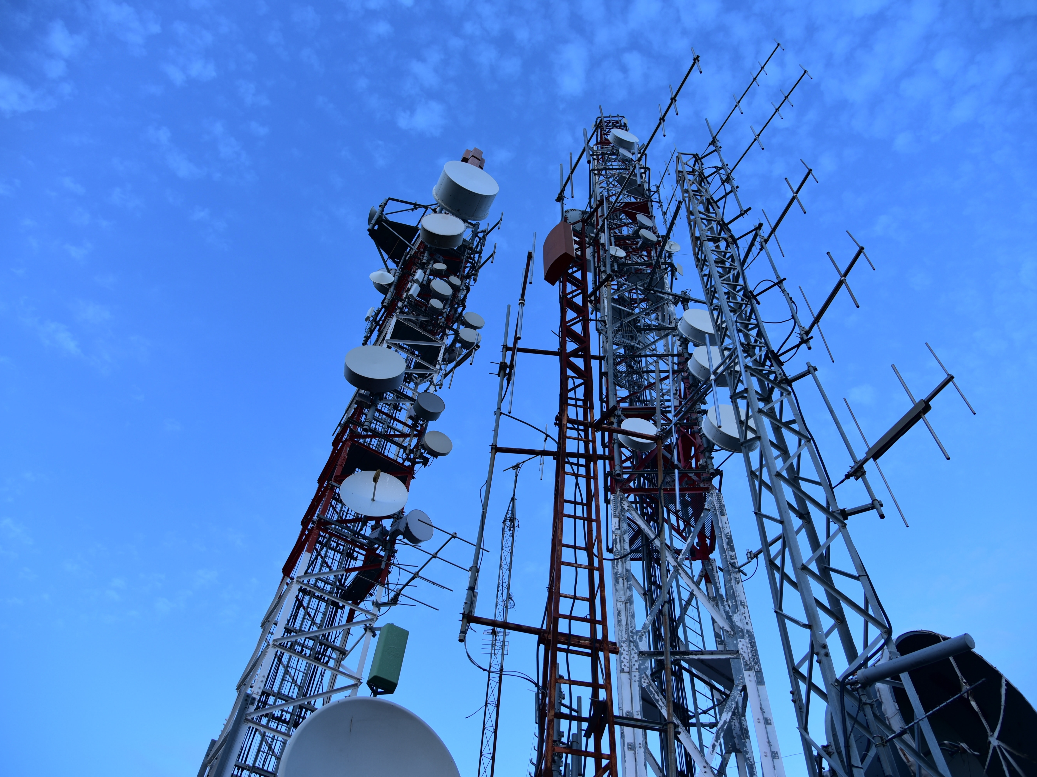
Beacon
Notes:
Hide transmitters in secret locations, one for each clue that you make up.

Slide 25
from microbit import *
import radio
# change the number and the clue
number = 1
clue = "Walk Fifteen paces east”
radio.on()
radio.config(power=2)
while True:
clue_text = str(number) + ":" + clue
radio.send(clue_text)
display.show(str(number))
sleep(1000)
Notes:
Easy beacon, no programming of clues
Change the number and clue text before flashing each one

Slide 26
from microbit import *
import radio
all_clues = [
"Walk Fifteen paces east",
"Ten paces north",
"Walk forwards",
"Look under the seat",
"Hooray, you win!"
]
Notes:
Harder version - part 1 - list of clues

Slide 27
clue_count = len(all_clues)
clue = 1
radio.on()
radio.config(power=2)
while True:
if button_a.was_pressed():
clue = max(clue - 1, 1)
elif button_b.was_pressed():
clue = min(clue + 1, clue_count)
else:
clue_text = str(clue) + ":" + all_clues[clue - 1]
radio.send(clue_text)
display.show(str(clue))
sleep(1000)
Notes:
Harder version - part 2, push a button to increase and b to decrease clue.
Also - replace display.show() with display.set_pixel(2, 2, 9 -> 0) to flash centre pixel to show broadcast.

Slide 28
Friday
Notes:
Tomorrow we will be creating some projects for show and tell. Think about what you would like to do.

Slide 29
Functions
def say_something():
display.scroll(‘hi’)
say_something()
Notes:
Reusable chunks of code
Must come first before being used so python sees them and puts them away
Arguments
Return values

Slide 30
Functions
def say_something(message):
display.scroll(message)
say_something(‘hey’)
say_something(‘hi’)
say_something(‘hello’)
Notes:
Reusable chunks of code
Arguments
Return values

Slide 31
Functions
def is_it_bob(name):
return name == “bob”
if is_it_bob(person_name):
display.scroll(‘hi bob’)
Notes:
Reusable chunks of code
Arguments
Return values

